Slide 1
PACIO Project
Weekly meeting
May 15, 2020

Slide 2
Agenda
HL7 Connectathon 24 Overview
PACIO-eLTSS Post-Acute Care Transition Track
Purpose of this track
Use case description and diagram
System diagram
Scene-by-scene screen captures
What went well
Challenges
Care Coordination Track
eCQM Testing
Connectathon Feedback
Next Steps for the PACIO Project

Slide 3
HL7 Connectathon Overview
What is a Connectathon?
An opportunity for multiple vendors to test the client and/or server in a structured environment and provide constructive feedback
A connectathon can be described as a “test kitchen” and the Implementation Guide as a “recipe” that can be tested and refined by participants
HL7 FHIR Connectathon 24
Hosted from Wednesday, May 13 till Friday, May 15th
This was HL7’s first virtual connectathon
Over 600 people attended/participated
PACIO Project hosted the PACIO-eLTSS Post-Acute Care Transition Summary Track
Also participated in the Care Coordination Track

Slide 4
PACIO-eLTSS Post-Acute Care Transition Track

Slide 5
Purpose of the PACIO-eLTSS Track
Test integration of CMS assessment data elements from the Data Element Library (DEL) into health IT systems using FHIR APIs.
Exchange patient level cognitive and functional status data between two disparate health IT (HIT) systems, incorporated with electronic Long-Term Services and Support (eLTSS) care plan and patient goals data, in a consumable format for clinicians, patients, and family members.

Slide 6
Connectathon Participants
Organizations
Altarum
MITRE
Patient Centric Solutions
Track Leads
Ty Mullen, tmullen@mitre.org
Siama Rizvi, rizvi@mitre.org
Sean Mahoney, smahoney@mitre.org
Dave Hill, dwhill@mitre.org

Slide 7
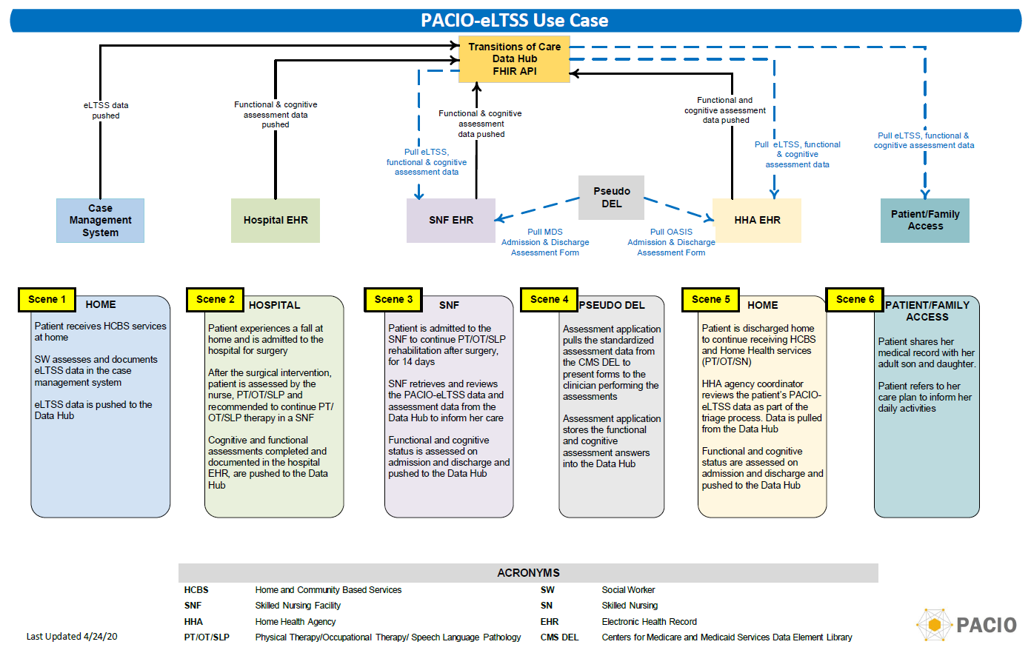
Use Case Diagram

Slide 8
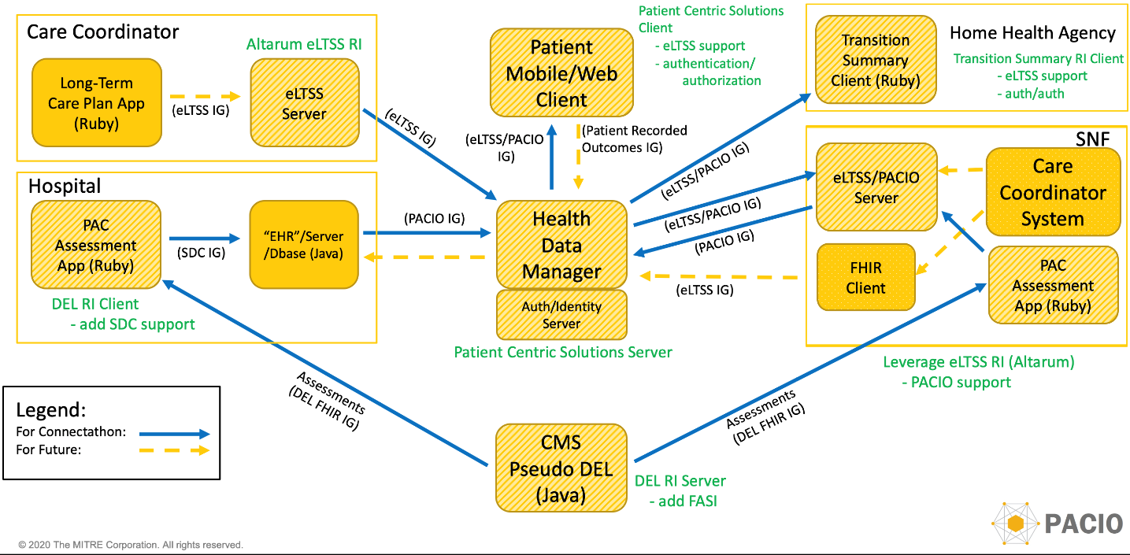
System Diagram
Scene 5
Scene 1
Scene 6
Scene 3
Scene 2
Scene 2
Scene 3
Scene 2
Scene 3
Scene 4

Slide 9
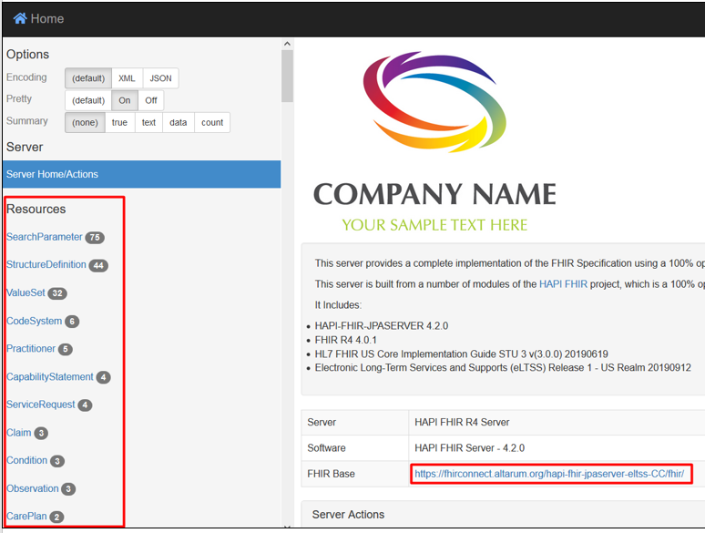
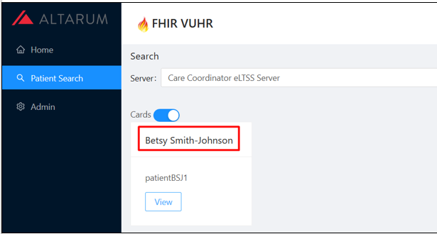
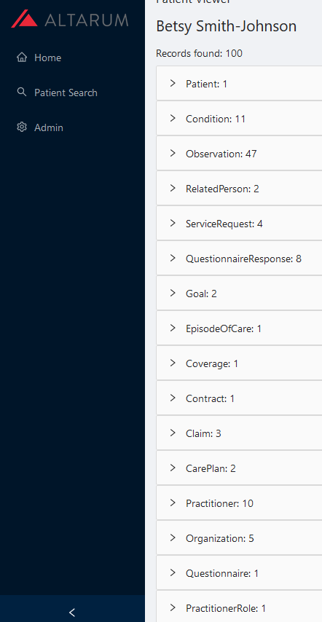
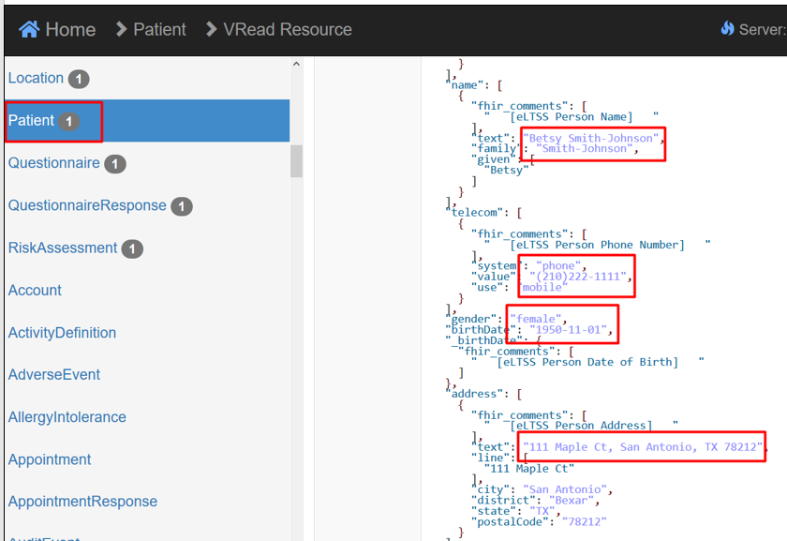
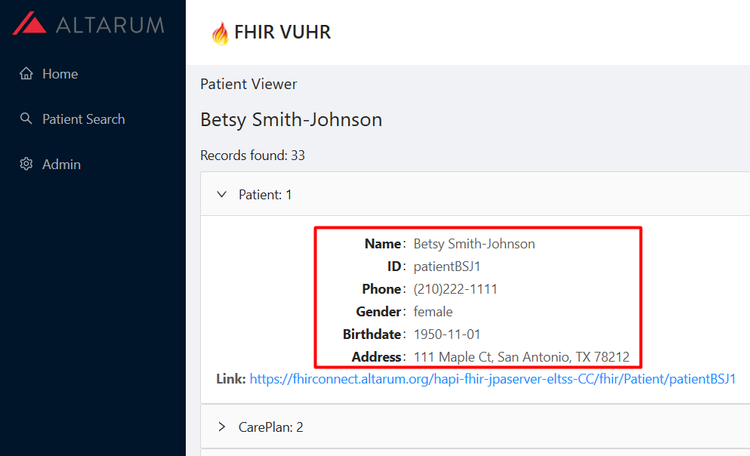
Scene 1 Screen Capture
Ms. Betsy Smith Johnson receives home community-based services (HCBS) services at home. A social worker documents eLTSS data including care plan and goals. eLTSS data is pushed to the Data Hub.
Server
Viewer
Push to Data Hub
Notes:
The Care Coordinator fills out a form and pushes the data to the eLTSS server. The eLTSS server pushes that data to the Data Manager for access later in the use case.

Slide 10
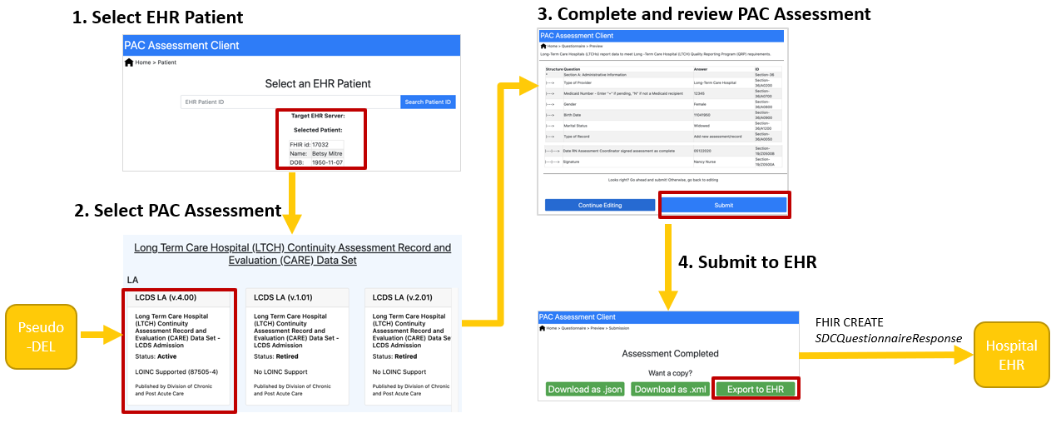
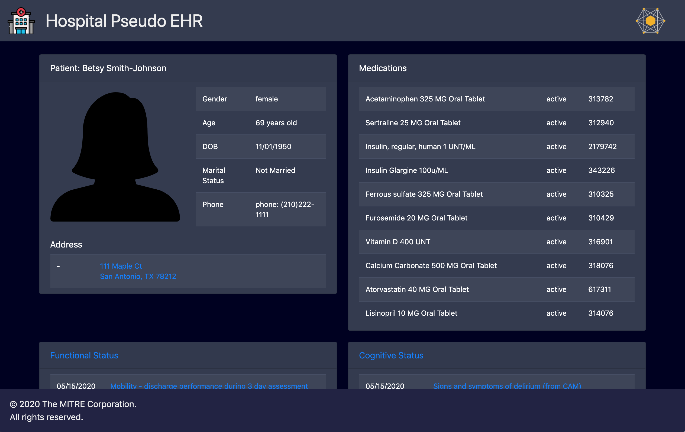
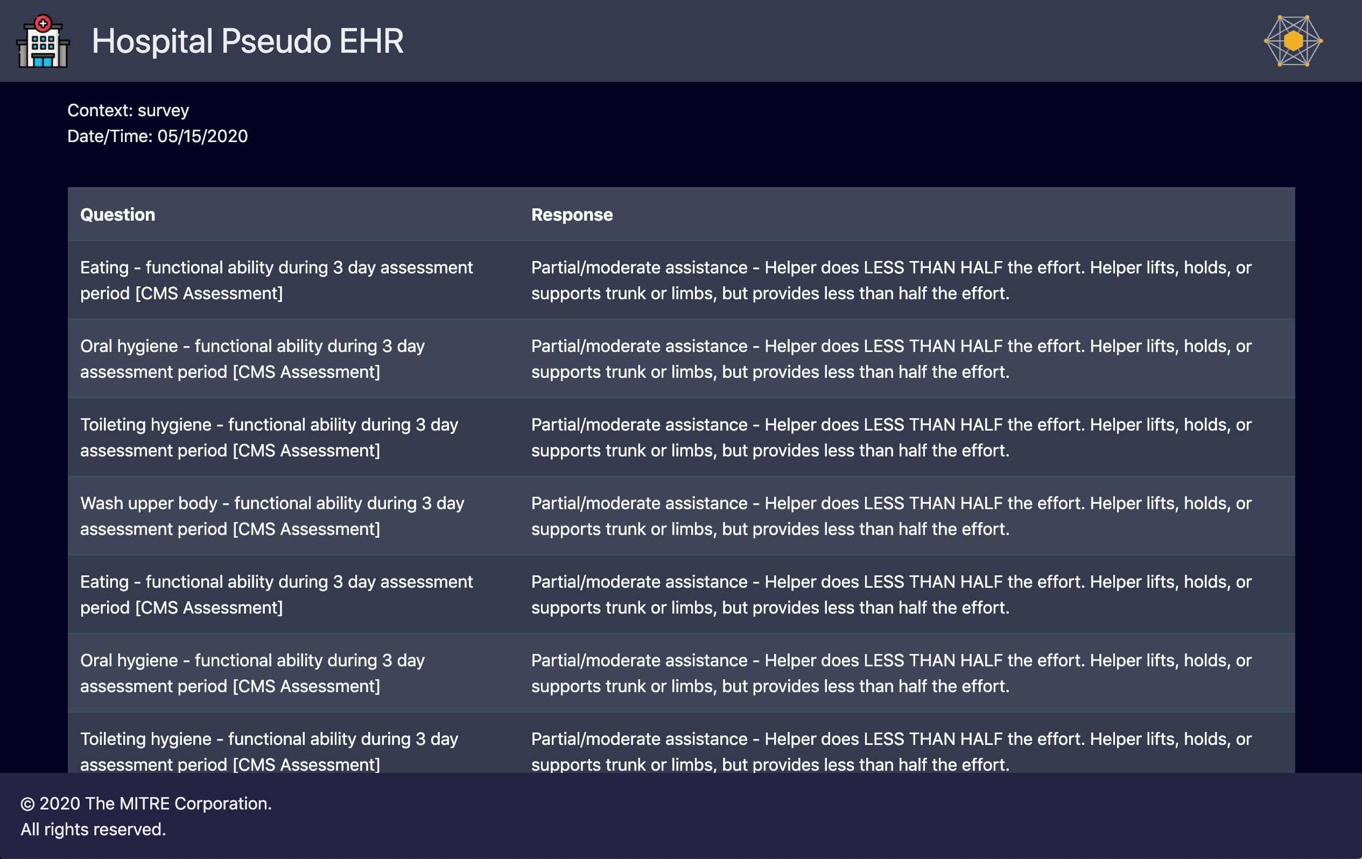
Scene 2 Screen Capture
Betsy experiences a fall at home and is admitted to the hospital for surgery. After the surgical intervention, Betsy is assessed by physical, occupational & speech language pathology therapists (PT/OT/SLP) and is recommended to continue her therapy in a skilled nursing facility (SNF). Cognitive and functional assessments completed and documented in the hospital EHR are pushed to the Data Hub.
Selects the EHR Patient for the PAC Assessment
Queries the pseudo-DEL for the list of available PAC Assessments
Converts the completed PAC Assessment QuestionnaireResponse to Structured Data Capture (SDC)
Sends the converted SDC QuestionnaireResponse to the EHR
Notes:
The clinician fills out the assessment form provided by the PAC Assessment App, which pulls the standardized assessments through the FHIR API of the Pseudo-DEL. When complete, the clinician submits the form which is sent to the Hospital EHR using the Structured Data Capture FHIR resources. The Hospital EHR extracts the Structured Data Capture resources into PACIO Observation-based resources for easier querying and sends the PACIO resources to the Data Manager. Hospital clinicians can view the latest information about the patient in the pseudo-EHR.

Slide 11
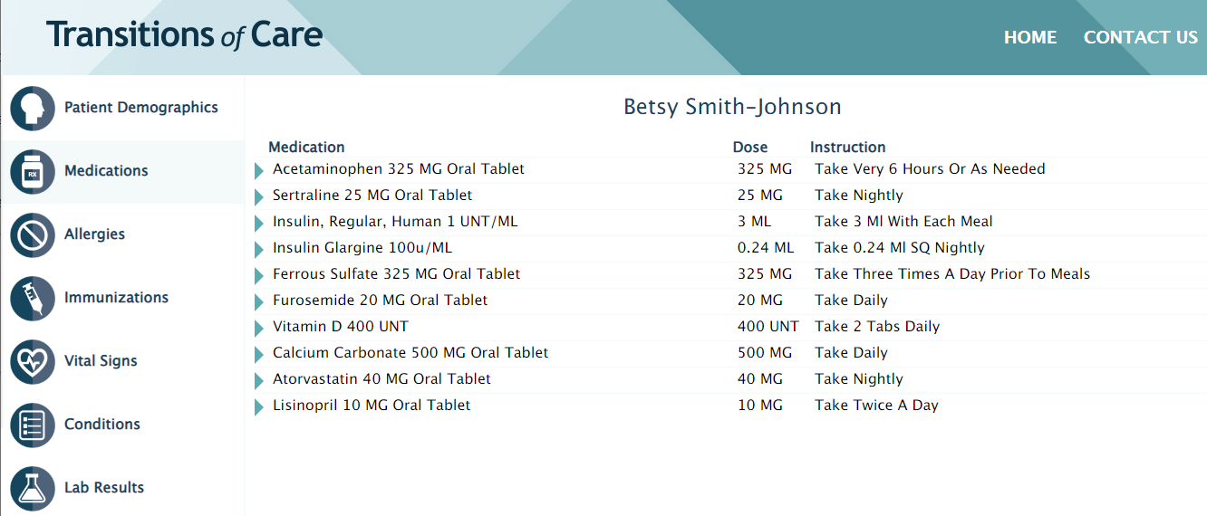
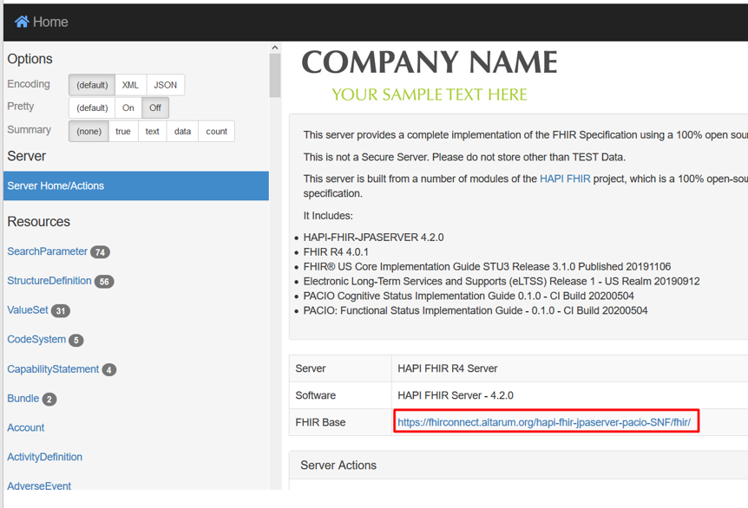
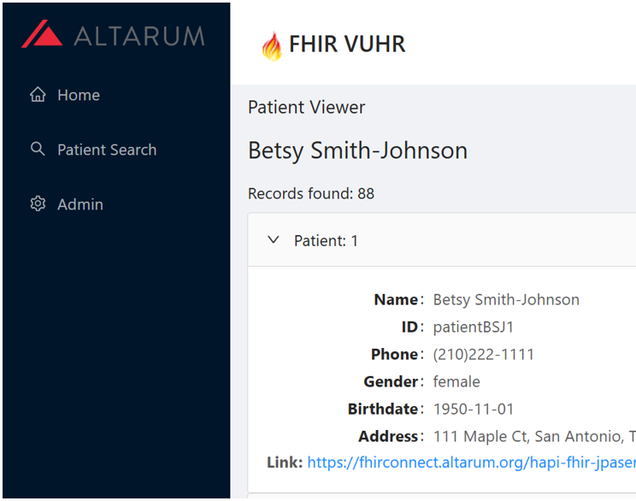
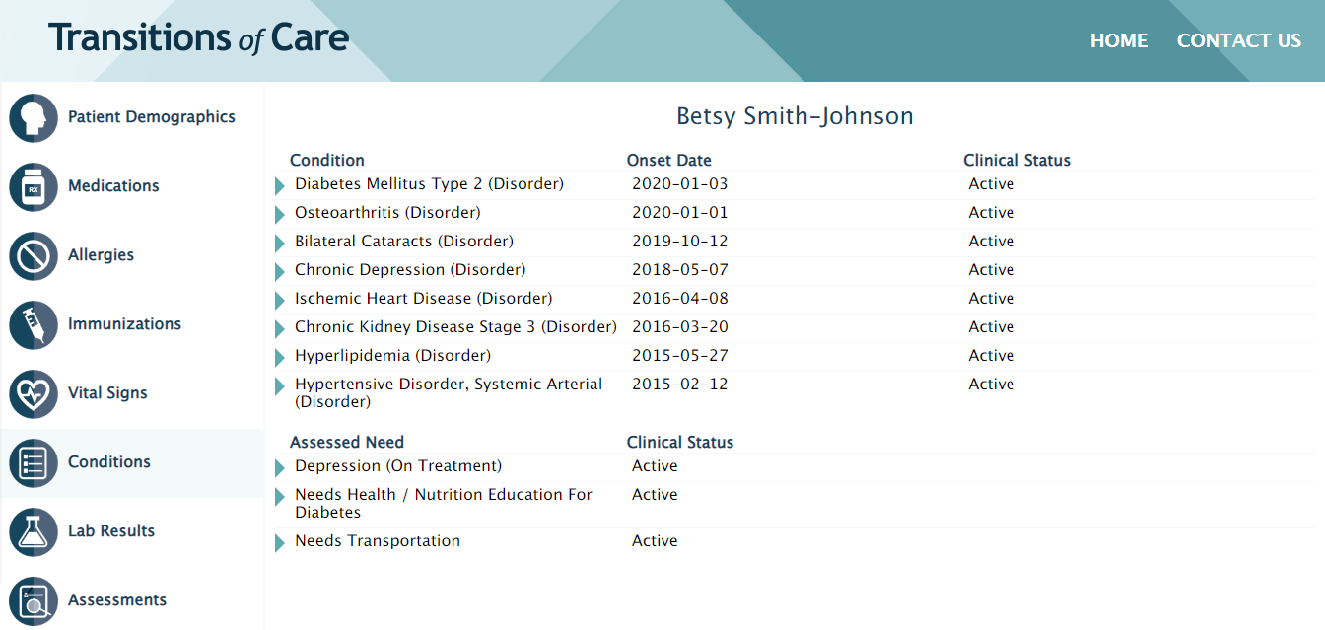
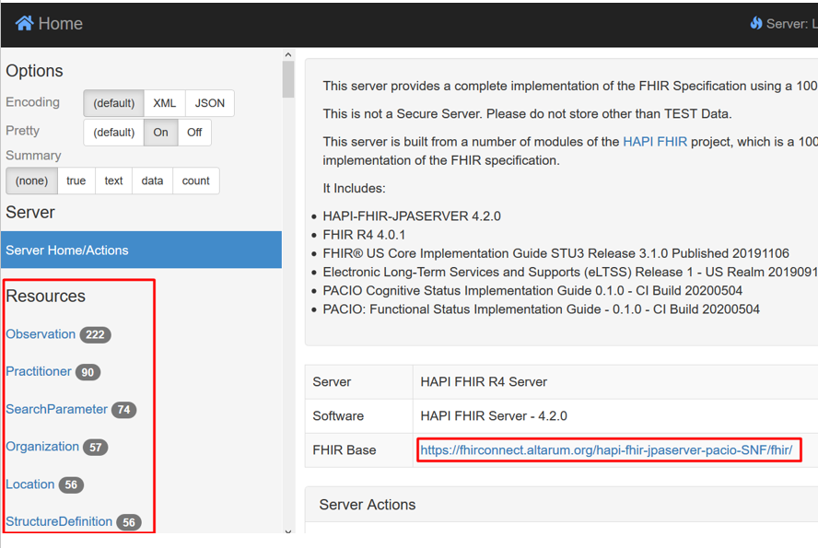
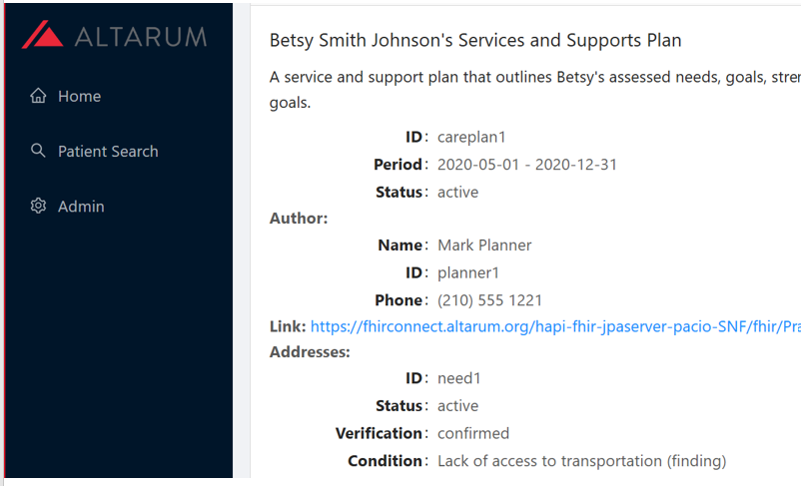
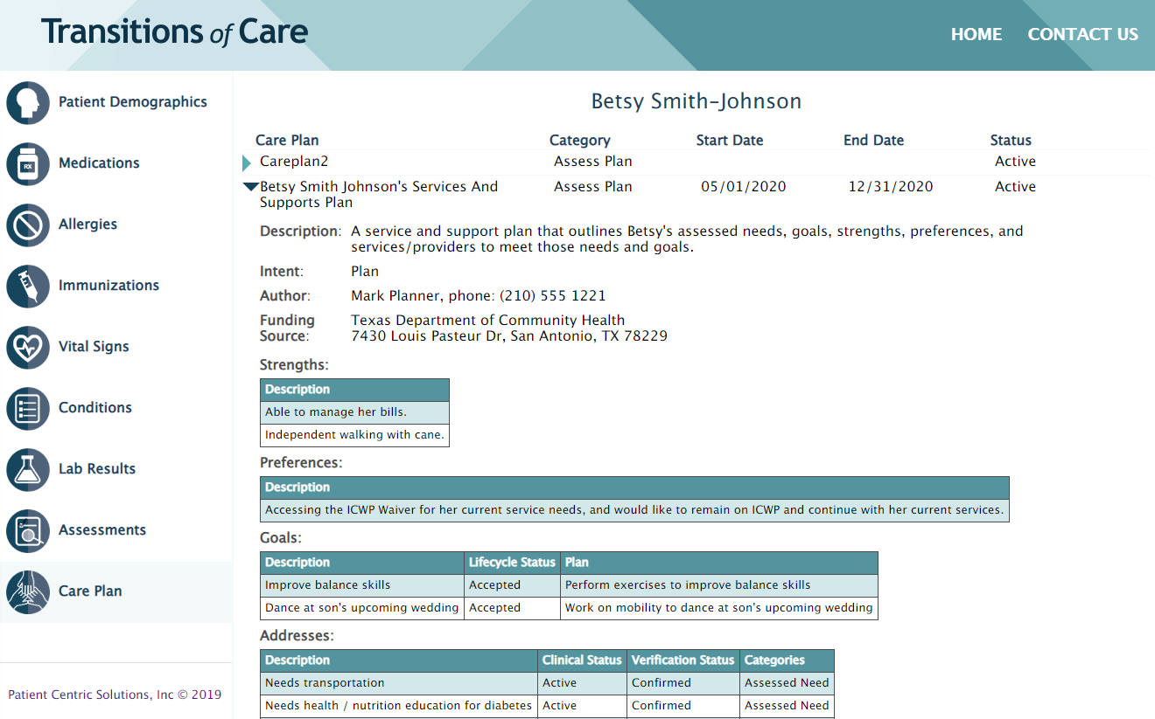
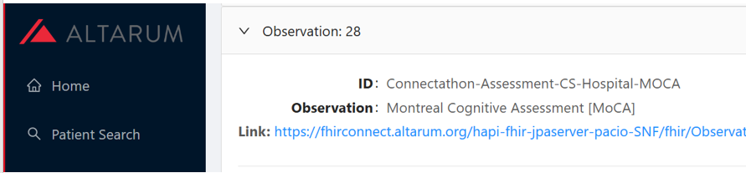
Scene 3 Screen Capture
Betsy is admitted to the SNF for PT/OT/SLP services for 14 days. The SNF retrieves the eLTSS data and assessment data from the Data Manager to inform her care. Functional and cognitive status is assessed on admission and discharge and pushed to the Data Hub.
Notes:
This screen is showing the clinician retrieving data in the SNF from the data hub- right?. I recommend changing the language too “The patient, Betsy is admitted to the SNF, where the clinician retrieves the latest clinical information stored in the data hub

Slide 12
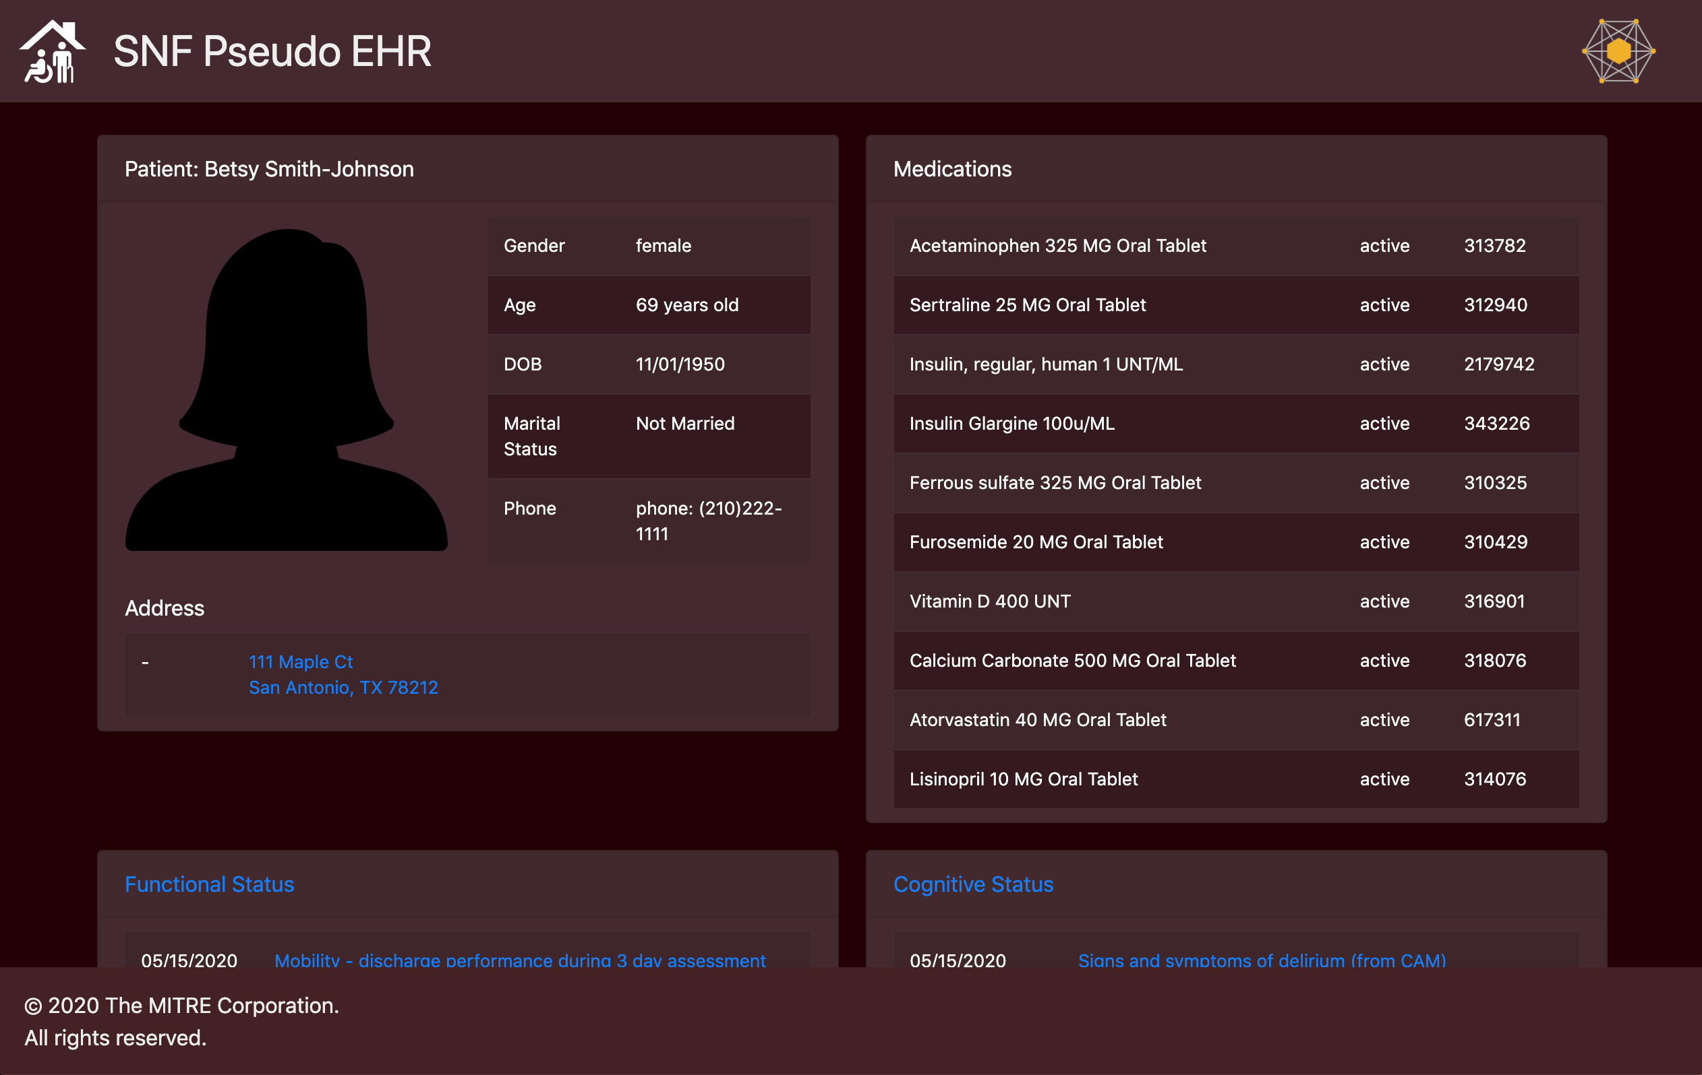
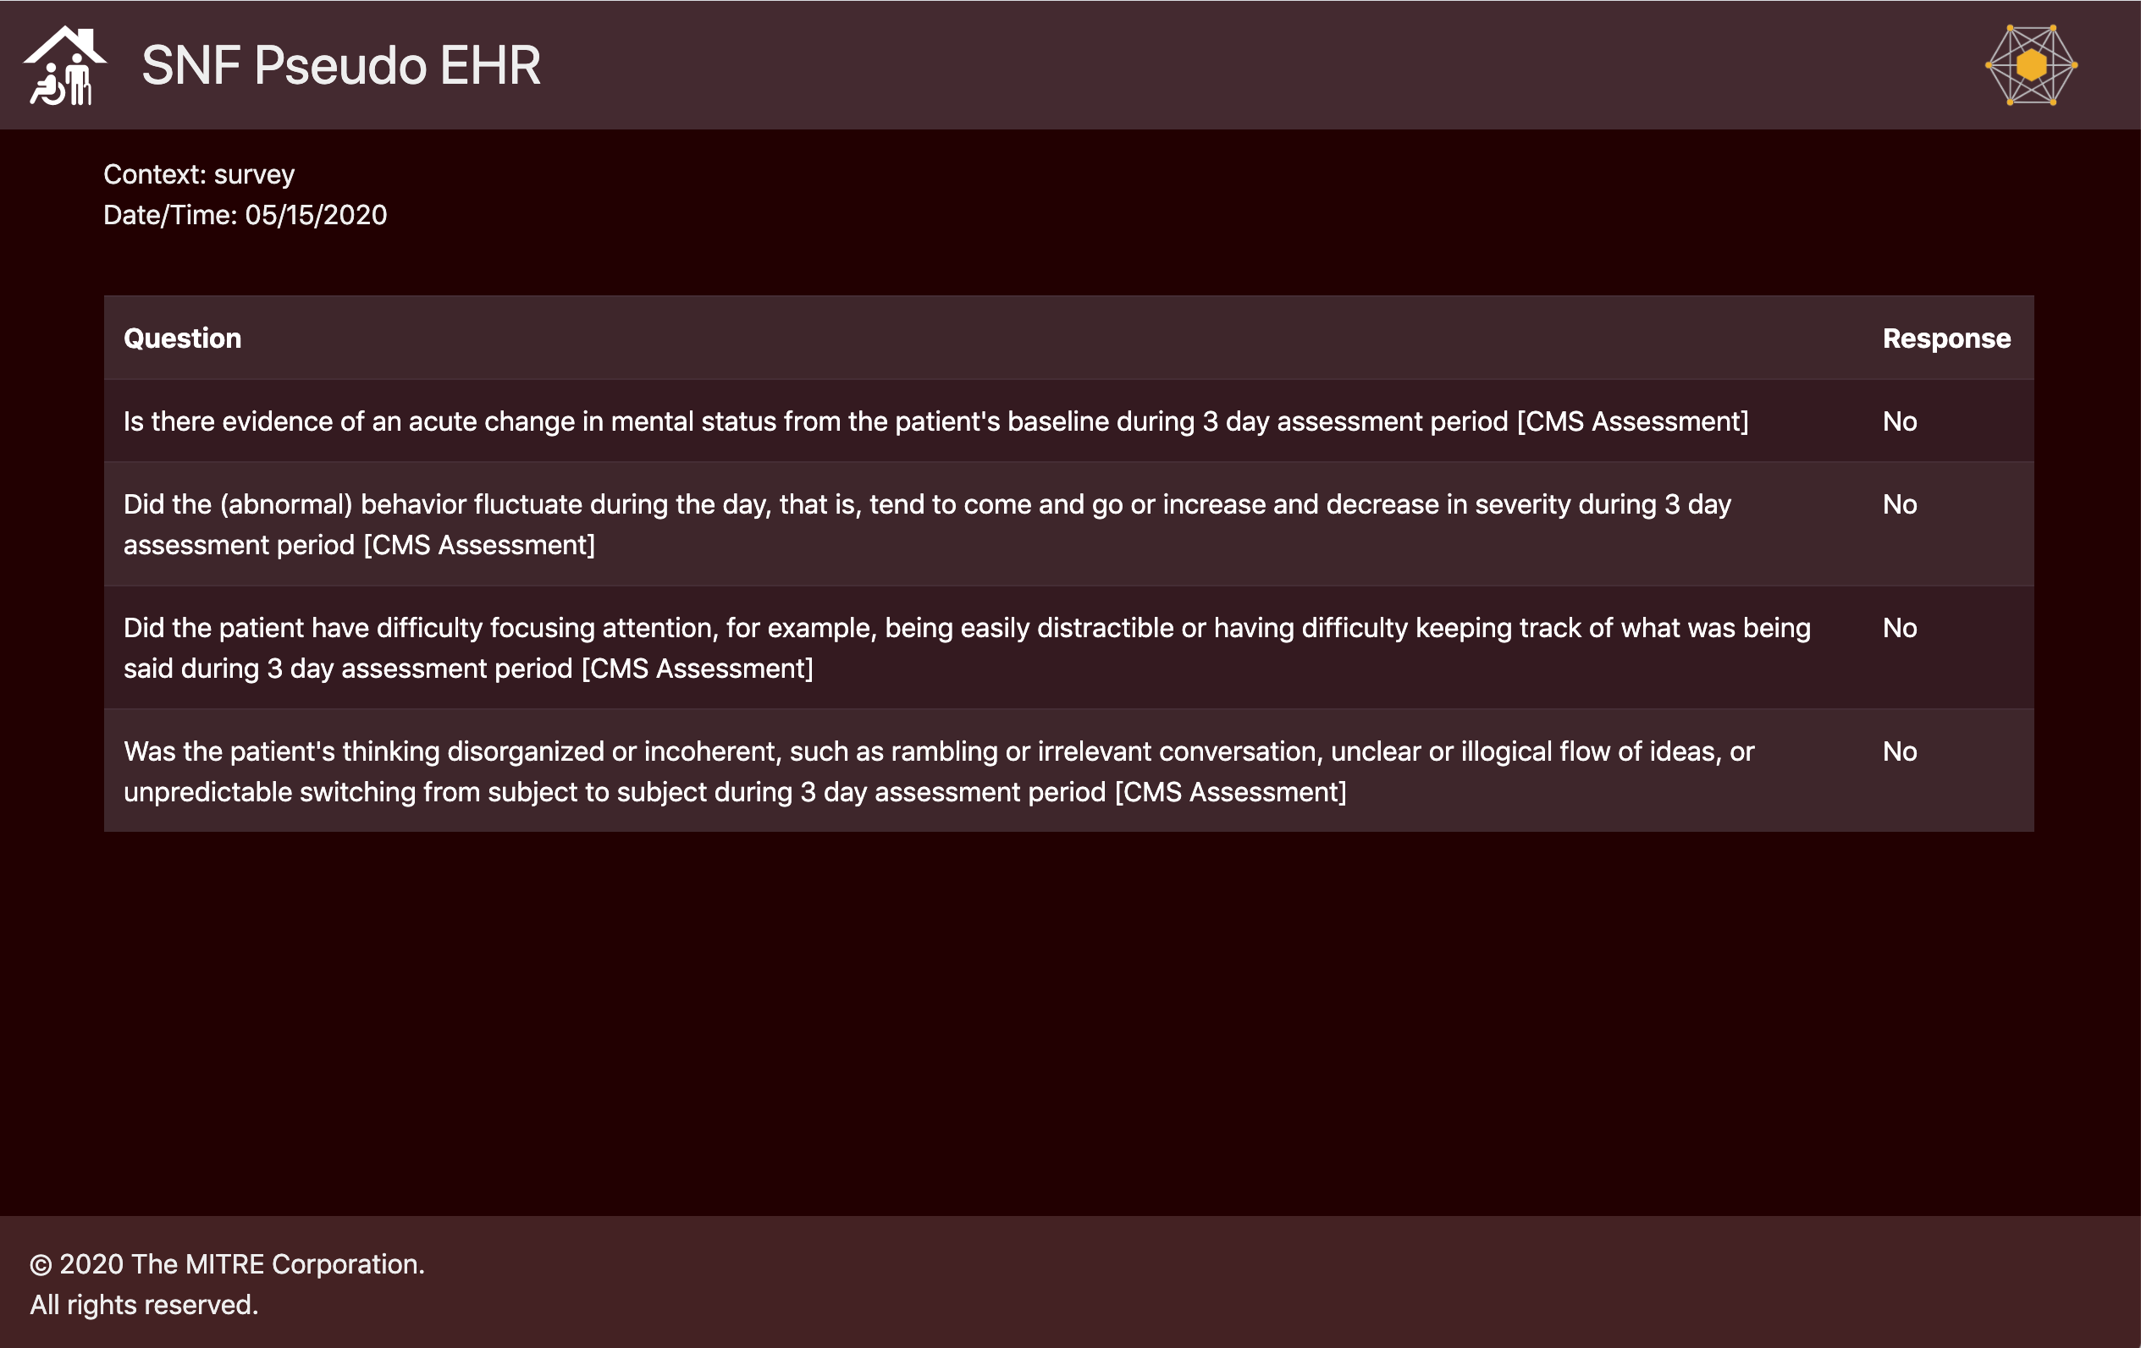
Scene 4 Screen Capture
The assessment application pulls the standardized assessment data from the CMS DEL and presents forms to the clinician performing the assessments.
Notes:
As in scene 2, the SNF clinician fills out an assessment form in the PAC Assessment App, again pulling the form information from the Pseudo-DEL. The form is submitted to the SNF Pseudo EHR, which extracts the data into PACIO resources and posts them to the Data Manager. SNF clinicians can see the assessments done at the hospital as well as at the SNF.

Slide 13
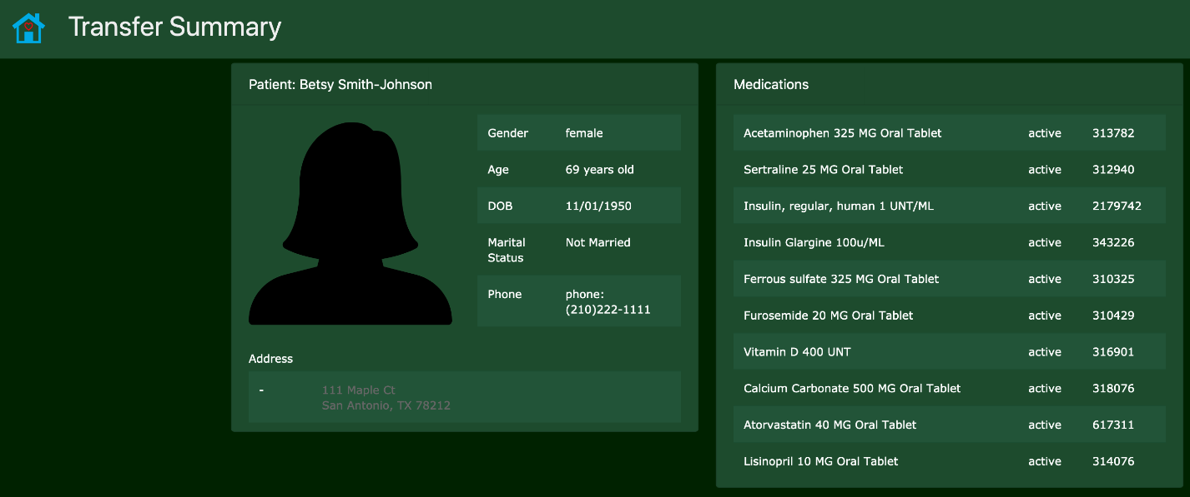
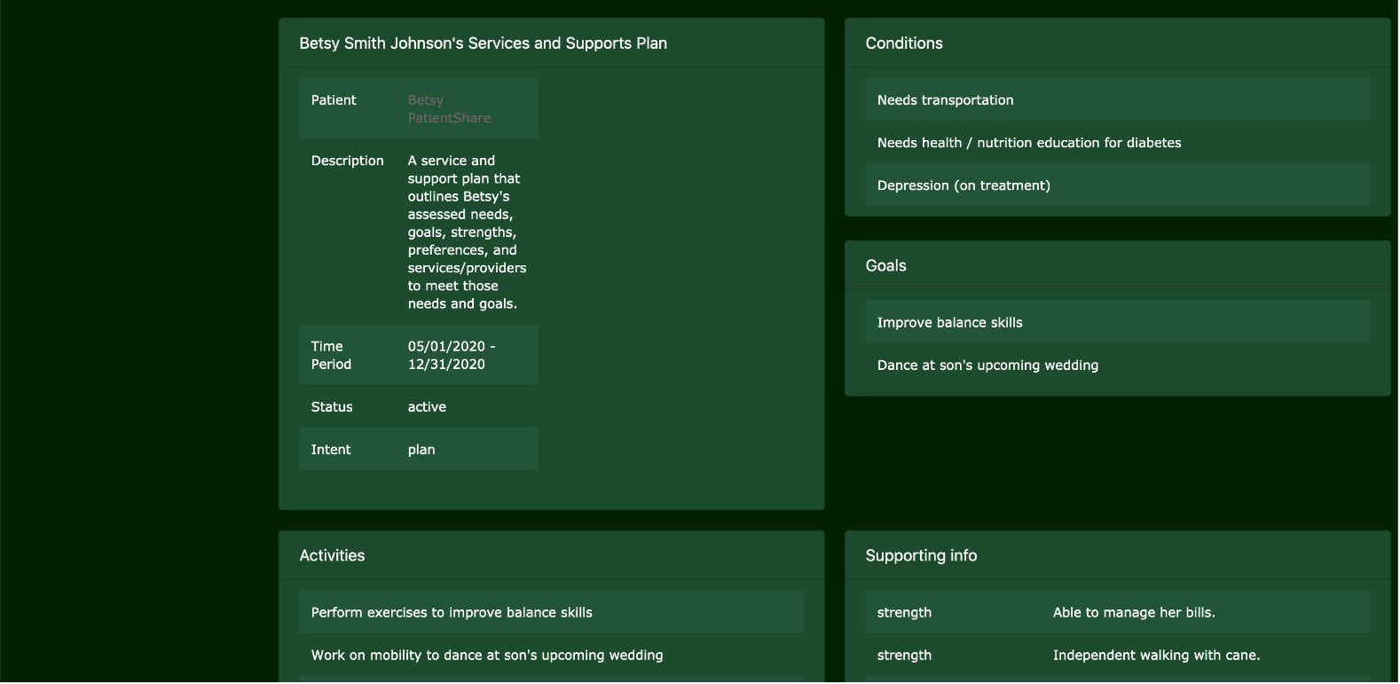
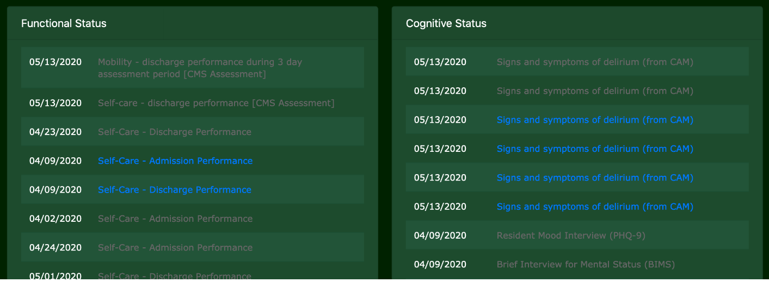
Scene 5 Screen Capture
After 14 days, Betsy is ready for discharge back home. The HHA agency coordinator reviews the patient's data from the Data Manager as part of the triage process.
Notes:
The patient is discharged from the SNF to HHA. The HHA system can access the information entered by the Hospital and SNF as well as the eLTSS information from the Care Coordinator, so the HHA has all of the information for the patient.

Slide 14
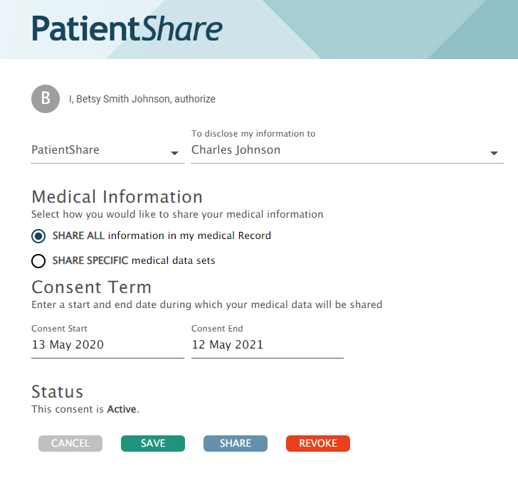
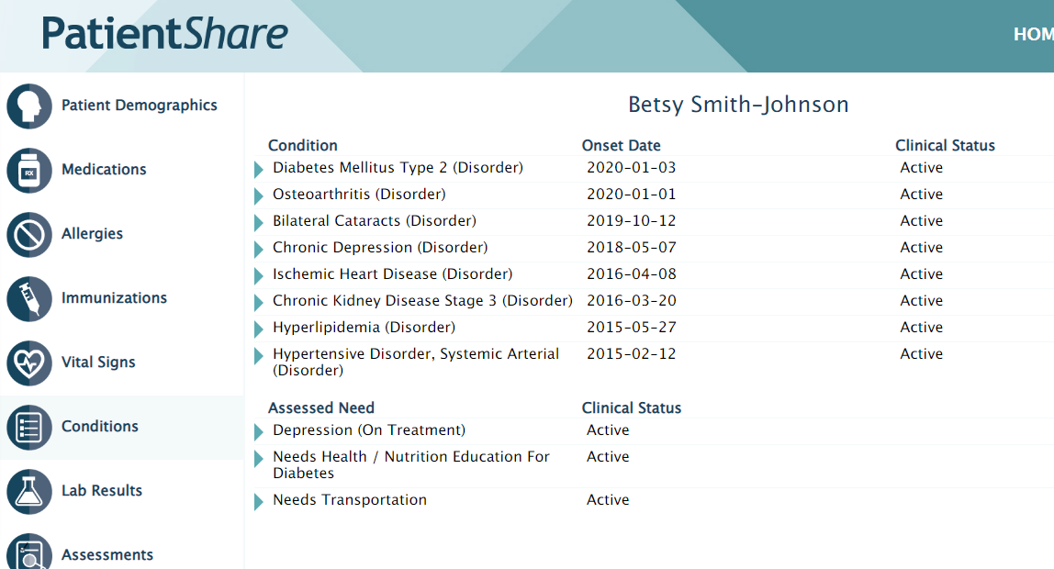
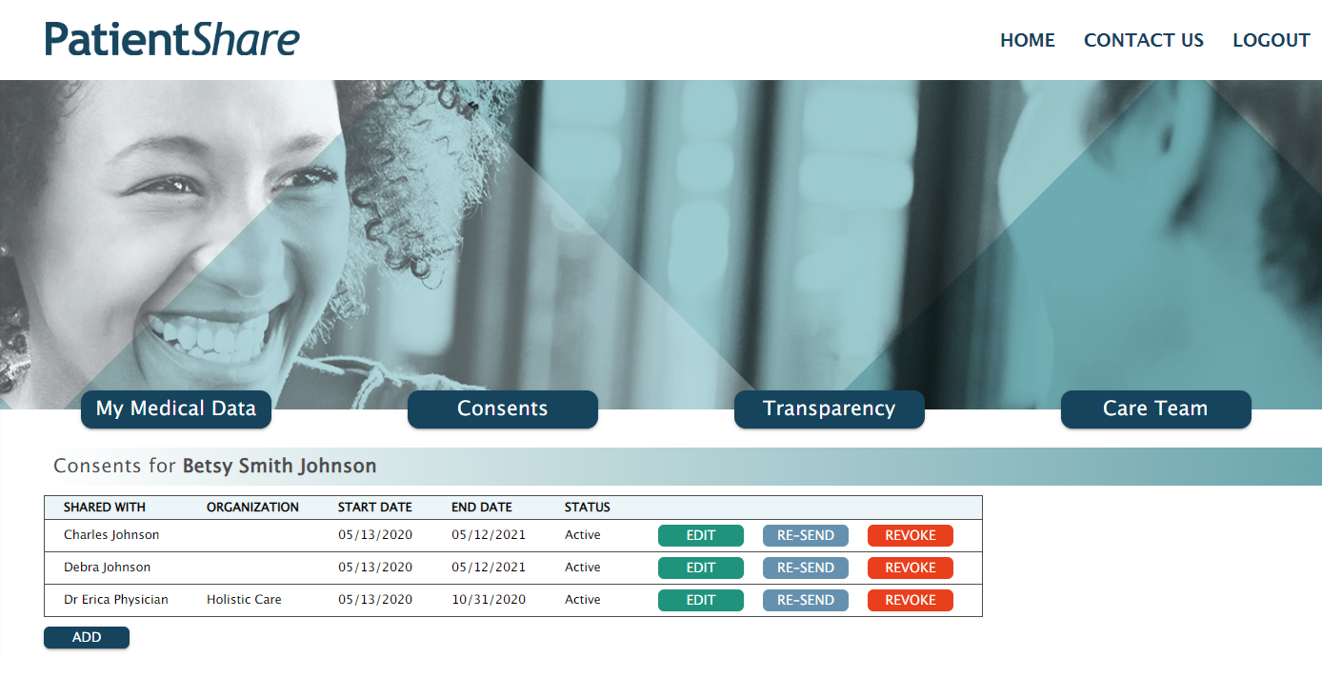
Scene 6 Screen Capture
While at home, Betsy and her authorized family caregiver access the eLTSS data and assessment data through a patient mobile/web application.
Notes:
All along the process, the patient Betsy, can access all of the information from the Care Coordinator, Hospital, and SNF during her healthcare journey, so she can make the best decision about her care. Betsy has a son, Charles, who is also interested in her care. Through the Patient Share application, Betsy can give electronic consent to Charles so that, through his own account and identity, can access his mother’s data.

Slide 15
What Went Well
Over 30 participants have been attending the track
Collaborated with the eLTSS and the Care Coordination tracks
Patient Centric Solutions’ and MITRE’s client was able to get PACIO and eLTSS data from the Altarum server, first time, with no prior integration work
That is a testament to the interoperability of the eLTSS and PACIO IGs

Slide 16
Challenges
Assessment data coming from Pseudo-DEL sometimes does not contain LOINC codes for answers
Requires an additional mapping step to work with PACIO resources, which require LOINC codes

Slide 17
Care Coordination Track
MATt Elrod (maxmd)
functional status group-clinical lead

Slide 18
Care Coordination Track: Objective
Demonstrate the use of FHIR across the continuum of health care and social services data exchange and explore alignment opportunities across the following active FHIR-based initiatives:
PACIO functional and cognitive status for post-acute care (CMS Medicare)
eLTSS person-centered long-term services and supports care plans
Gravity social determinants of health (SDOH) data interoperability
Bidirectional Services eReferral (BSeR) closed-loop electronic referrals
Multiple Chronic Conditions (MCC) eCare Plan: MCC Dynamic Care Planning
https://confluence.hl7.org/display/FHIR/2020-05+Care+Coordination+Track

Slide 19




Care Coordination Track: Participants
Care Coordination System Actors | Name | Organization | Logo
PMEHR (HHA), (Hospital),(SNF), ScreeningApp | Patient App, and CMS DEL | David Hill | MITRE
HIE/Hub and Patient App | Nancy Lush | Patient-Centric Solutions
PMEHR (PCP) and ScreeningApp | Patient App | Lisa Nelson | MaxMD
HCBS Case Management System and HCBS Eligibility System | Forrest White | Altarum

Slide 20
Care Coordination Track: Scenes
Focus on Scene 1 and Scene 9 at the May Connectathon.
Person receives home and community-based services (HCBS) at home
Person/Patient falls and is hospitalized
Pre-discharge, patient is evaluated for functional and cognitive status
Patient is discharged to SNF
Patient is admitted to SNF
Patient is discharged to Home Health
Patient is admitted to HHA Services and continues HCBS
Patient is discharged from HHA and follows up with PCP
Person receives and reviews her updated assessments and plan information

Slide 21
Care Coordination Track: Notable Achievement
Coordinated with two tracks (PACIO and Gravity) to demonstrate data exchange as it relates to:
Conducting a social risk screening and generating an eReferral for further evaluation
Completing and exchanging a functional & cognitive assessment status
Exchanging an eLTSS plan
Achievements include:
Demonstrated use of multiple FHIR resources and FHIR IGs used to conduct a social risk screening, eReferral, functional assessment, and eLTSS plan query and exchange
Provided new testing experience for multiple first-time Connectathon participants
Introduced comprehensive data exchange opportunity across the continuum of care

Slide 22
Care Coordination Track: Issues/Questions
Unable to show the eReferral in the HIE/Hub and patient app system
Unable to find a system actor to create the eLTSS Plan using the FHIR CarePlan resource; eLTSS plan used for query and exchange was developed prior to the Connectathon
Discussed how to represent DEL functional assessment questions and answers in the EHR
Discussed opportunity to better address model of use vs model of meaning; too many times providers answer questions for an assessment because they are on the form vs adding observations based on the care they need to provide to the patient
For demonstration only we used the PACIO Functional Assessment Status FHIR IG to build the Functional Assessment status data; however, the PACIO IG does not incorporate person-centered related questions available in the FASI data set used for HCBS screening.

Slide 23
Care Coordination Track: Next Steps
Update the PACIO Functional Assessment Status IG to incorporate missing person-centered FASI elements (HCBS assessments)
Incorporate lessons learned and feedback from track participants into the plans for Sept 2020 Connectathon Care Coordination Track
Continue to encourage EHR providers and HIE’s to join the care coordination track to support testing and facilitate the creation and exchange of FHIR enabled Care Plans
Reach out to patient advocacy groups and encourage Connectathon participation
Identify participants from OCHIN that can demonstrate social risk screening and care planning

Slide 24
eCQM Testing
Rob Samples (esac)
Cognitive status group-technical lead

Slide 25
Connectathon 24- eCQM Testing
Collaborated with the Clinical Reasoning track to perform review of PACIO sample data using a quality measure use case
Selected CMS-149v9 Dementia: Cognitive Assessment
Measures the percentage of patients, regardless of age, with a diagnosis of dementia for whom an assessment of cognition is performed and the results reviewed at least once within a 12-month period
Currently specified as an eCQM using CQL and Quality Data Model
Converted data model to use FHIR and evaluated the measure using output data from PACIO connectathon
Utilized Atom, an open source text editor with language-cql package installed to convert eCQM to FHIR
Updated test data to conform to Clinical Reasoning file structure and use cases (i.e. normalize timing, update resource ids, create some missing resources.)
Executed Quality Measure against refined data to obtain a Numerator and Denominator result

Slide 26
Connectathon 24- eCQM Testing (Results)
Successfully evaluated Num/Den for the quality measure
Recommend continued collaboration between PACIO and Clinical Reasoning for evaluating differences in data models and data transfer mechanisms (i.e. measure report and DEQM)
Syncing up use cases prior to next Connectathon will avoid having to reformat data. There was minimal encounter data, which is critical to eCQM evaluation. Observation code was not found in measure code system.
Explore further integration between transfer of care summary and quality reporting use cases to reduce implementation burden

Slide 27
Connectathon Feedback

Slide 28
Connectathon Feedback
What went well?
What didn’t go well?
How can we improve?

Slide 29
Next Steps

Slide 30
Next Steps for PACIO Project
Technical team needs to meet to discuss discovered issues and possible ways to resolve them
Discuss issues and decide on the best course of action during PACIO meetings
Prepare for Balloting

